Slide 1

Image Forgery Detection and Localization Phase 2- Review 2, Mar 2025
Project Advisor : Dr. R. Aarthi, Assistant Professor (Sl.Gd.) ,
Amrita School of Computing, Coimbatore
SL.No | Roll No | Student Name | Section
1 | CB.EN.U4CSE21414 | C.Sahithee Vaibhav | CSE-E
2 | CB.EN.U4CSE21430 | K.Mahammad Sami | CSE-E
3 | CB.EN.U4CSE21440 | N.Ujwal Srimanth varma | CSE-E
4 | CB.EN.U4CSE21467 | Vinayakan VS | CSE-E

Slide 2
GUIDE APPROVAL SCREENSHOT

Slide 3
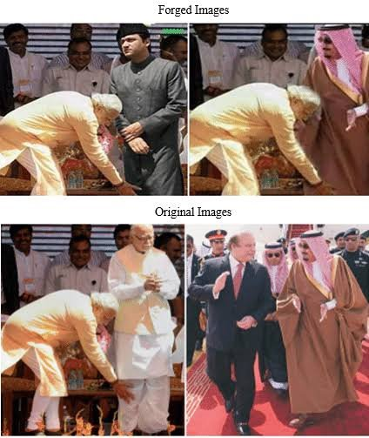
Objective and Problem Statement
To build an AI model for accurate forgery localization in images and documents, addressing critical impacts like misinformation, social harm, and public trust.

Slide 4
REVIEW-1 PANEL SUGGESTION AND WORK INCORPORATED
For ELA-CNN Model IoU score is calculated as 0.51
Model is checked with and without authentic images
F1-Score=0.57(without)
F1-Score=0.51(with)

Slide 5
WORK DONE AFTER PANEL REVIEW1
Scope Shift: Document Forgery Localization
Previous Work: Completed forgery detection for normal images with an AUC Score of 0.7678 and F1 score of 0.5712
Our current focus is on accurately localizing tampered regions in documents, as our previous model struggled with images containing less than 10% tampering. Since the majority of images in the document dataset fall into this category, improving detection in such cases is our priority.
Dataset:
Selected a diverse dataset from multiple online sources, including various document types and forgery methods.
Model Selection:
Experimented
Method: YOLOv8, UNET, Auto Encoder
Image processing techniques: Saliency, Canny edge, Noise Variance Map, ELA.
Goal: Accurate localization of forged regions.

Slide 6
Document Forgery Localization
1.Localization of Tampered Regions
Uses ML/DL models to highlight manipulated areas.
Helps in identifying copy-move, splicing, and alterations in documents.
2.Metadata Analysis[7,8]
Extracts hidden metadata (timestamps, editing history, software used).
Detects inconsistencies that indicate possible forgery.
3.Text Extraction & Database Verification (Limited to Government IDs)
Uses OCR to extract text from the document.
Cross-checks details against a government database to verify authenticity.
We tried to focus only on Method 1

Slide 7
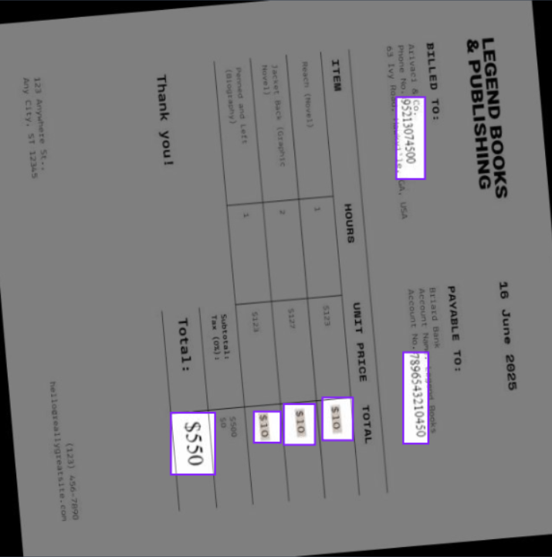
Dataset Description
Dataset - Document Forgery detection Computer Vision Project
Collected from roboflow-https://universe.roboflow.com/document-forgery-detection/document-forgery-detection
It consists of
Train images-887
Validation images-85
Test images-25
A model was deployed by roboflow with
Precision - 72.1%
Recall - 51.9%

Slide 8
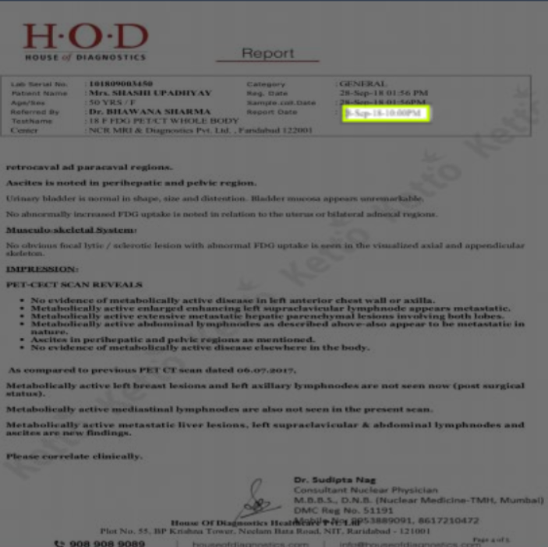
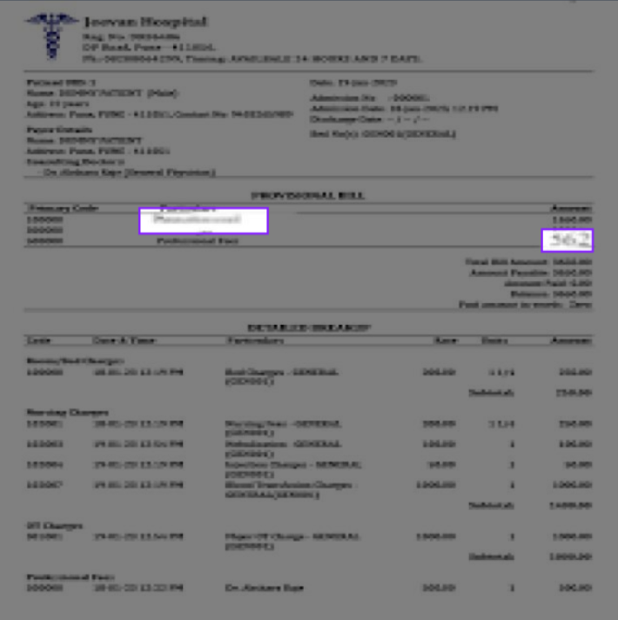
Dataset Description

Slide 9
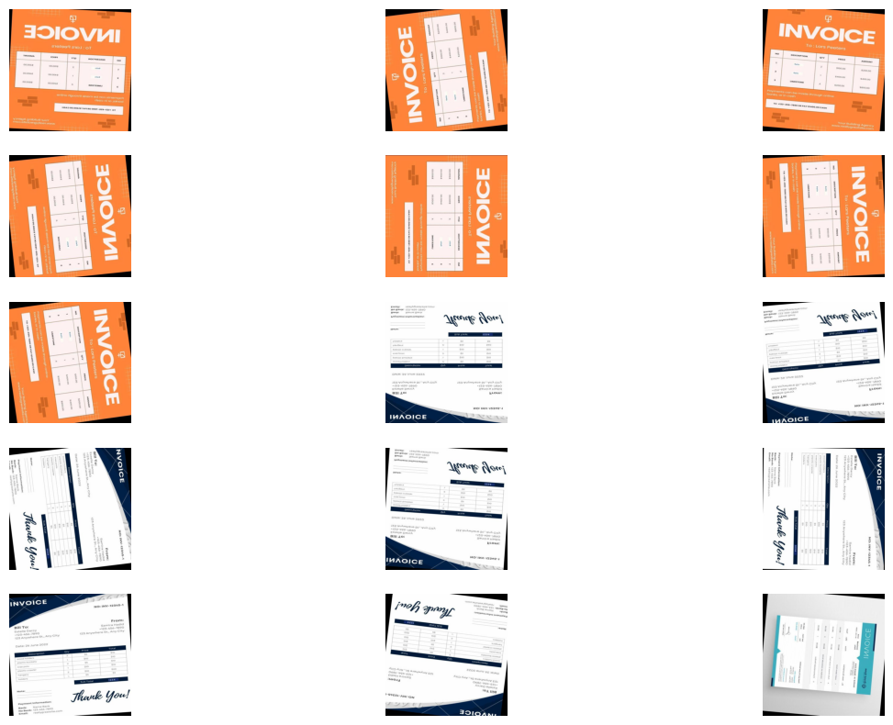
Dataset Description
Augmentations were used as the dataset is very small
Each image corresponds to 7 different images with different orientations

Slide 10
PROPOSED SYSTEM ARCHITECTURE
Pre trained YOLOv8
Training on dataset
weights
Experimenting the model with different set of configurations
Best Model
Evaluation
Hyperparameter tuning

Slide 11
YOLOv8
What is YOLO?:
YOLO(You Only Look Once) is a state-of-the-art object detection algorithm that performs real-time detection and localization.
Known for its speed and accuracy.
Why YOLO for this Project?:
Its ability to perform both object detection and localization in one forward pass.
Pre-trained weights that can be fine-tuned to our custom dataset.
Proven Performance in this field

Slide 12
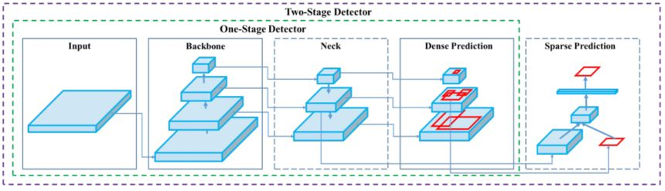
YOLOv8 Architecture
Backbone (Feature Extractor)
Uses CSPDarkNet to extract important features from images.
Converts images into feature maps for object recognition.
Neck (Feature Enhancement)
Uses Path Aggregation Network (PAN) to refine multi-scale features.
Helps detect small and overlapping objects effectively.
Head (Final Predictions)
Predicts bounding boxes, class labels, and confidence scores.
Uses anchor-free detection for accurate localization.
Backbone extracts features, Neck enhances them, and Head makes final predictions!

Slide 13
Fine-Tuning Pre-Trained Model
Pre-Trained Model:
Utilized YOLOv8l.pt, pre-trained on the COCO dataset with 80 classes.
Fine-Tuning Strategy:
Training the model on our dataset to adapt the weights accordingly.
Customizing the final layers for better alignment with our specific data.
Modified various hyperparameters (learning rate, batch size, etc.) to enhance accuracy.
Experimented with eight different configurations to refine performance.

Slide 14
Configurations used
Key Hyperparameters | Reason for Choosing These Settings
epochs=100, batch=16, imgsz=320, optimizer=AdamW | Standard settings for balanced datasets. Provides stable training without aggressive tuning.
imgsz=640, iou=0.8, lr0=0.005, optimizer=SGD | Larger image size & IoU improve small object detection, SGD ensures stability.
batch=32, epochs=50, augment=false, optimizer=AdamW | AdamW speeds up training, reducing augmentation improves training speed.
lr0=0.005, dropout=0.2, weight_decay=0.001, optimizer=SGD | SGD with weight decay prevents overfitting, dropout improves generalization.
imgsz=1024, iou=0.85, batch=4, optimizer=AdamW | Large image size captures fine text details, AdamW helps stable training.
hsv_v=0.5, auto_augment=true, optimizer=AdamW | Auto augmentation & brightness adjustments enhance robustness.
mosaic=1.2, mixup=0.5, scale=0.6, optimizer=SGD | SGD stabilizes aggressive augmentations, improving adaptability across datasets.

Slide 15
Best Model Configuration
task: detect
mode: train
model: best1l.pt
data: data.yaml
epochs: 100
time: null
patience: 100
batch: 16
imgsz: 320
save: true
save_period: -1
cache: false
device: cpu
workers: 8
project: null
name: train7
exist_ok: false
pretrained: true
optimizer: auto
verbose: true
shear: 0.0
perspective: 0.0
flipud: 0.0
fliplr: 0.5
bgr: 0.0
mosaic: 1.0
mixup: 0.0
copy_paste: 0.0
copy_paste_mode: flip
auto_augment: randaugment
erasing: 0.4
crop_fraction: 1.0
cfg: null
tracker: botsort.yaml
save_dir: runs\detect\train7
seed: 0
deterministic: true
single_cls: false
rect: false
cos_lr: false
close_mosaic: 10
resume: false
amp: true
fraction: 1.0
profile: false
freeze: null
multi_scale: false
overlap_mask: true
mask_ratio: 4
hsv_h: 0.015
hsv_s: 0.7
hsv_v: 0.4
degrees: 0.0
translate: 0.1
scale: 0.5

Slide 16
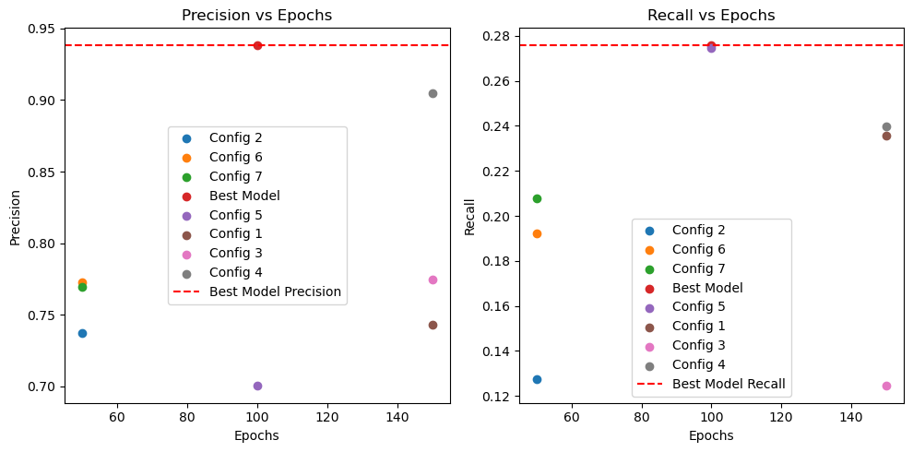
Performance Metrics

Slide 17
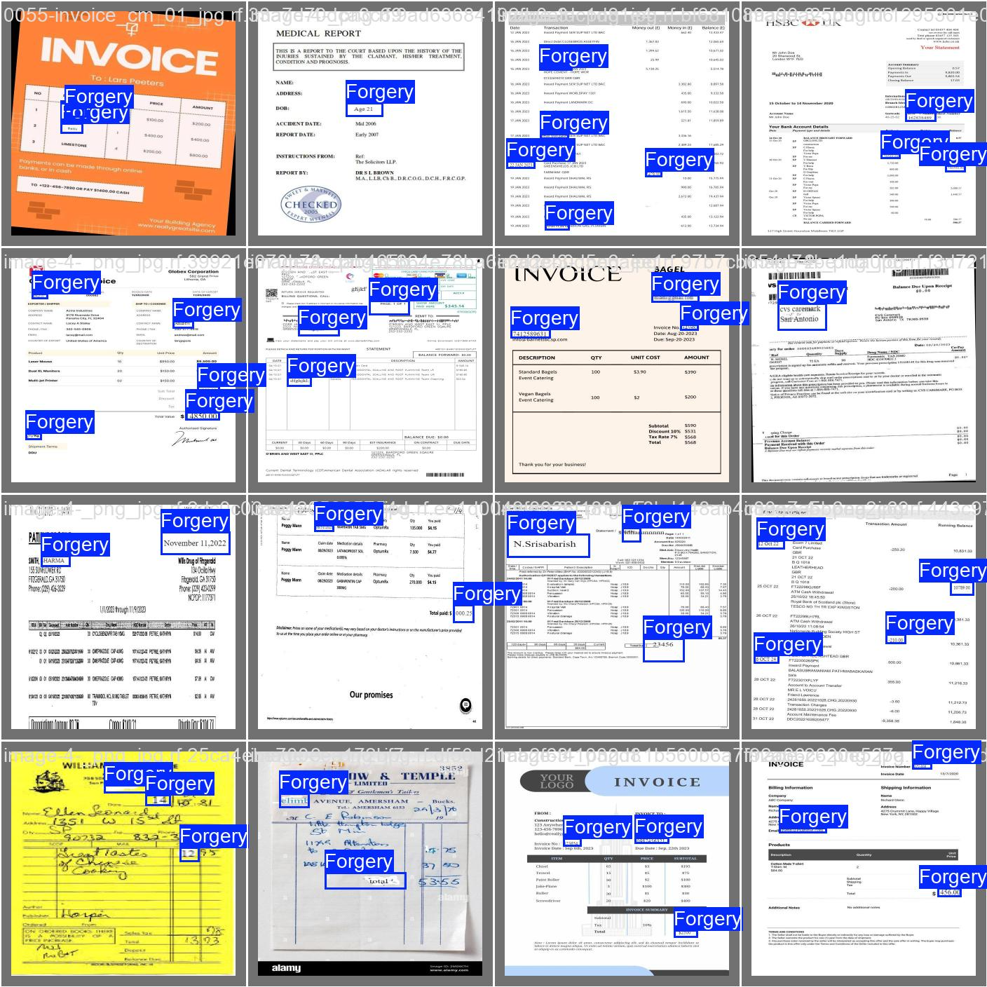
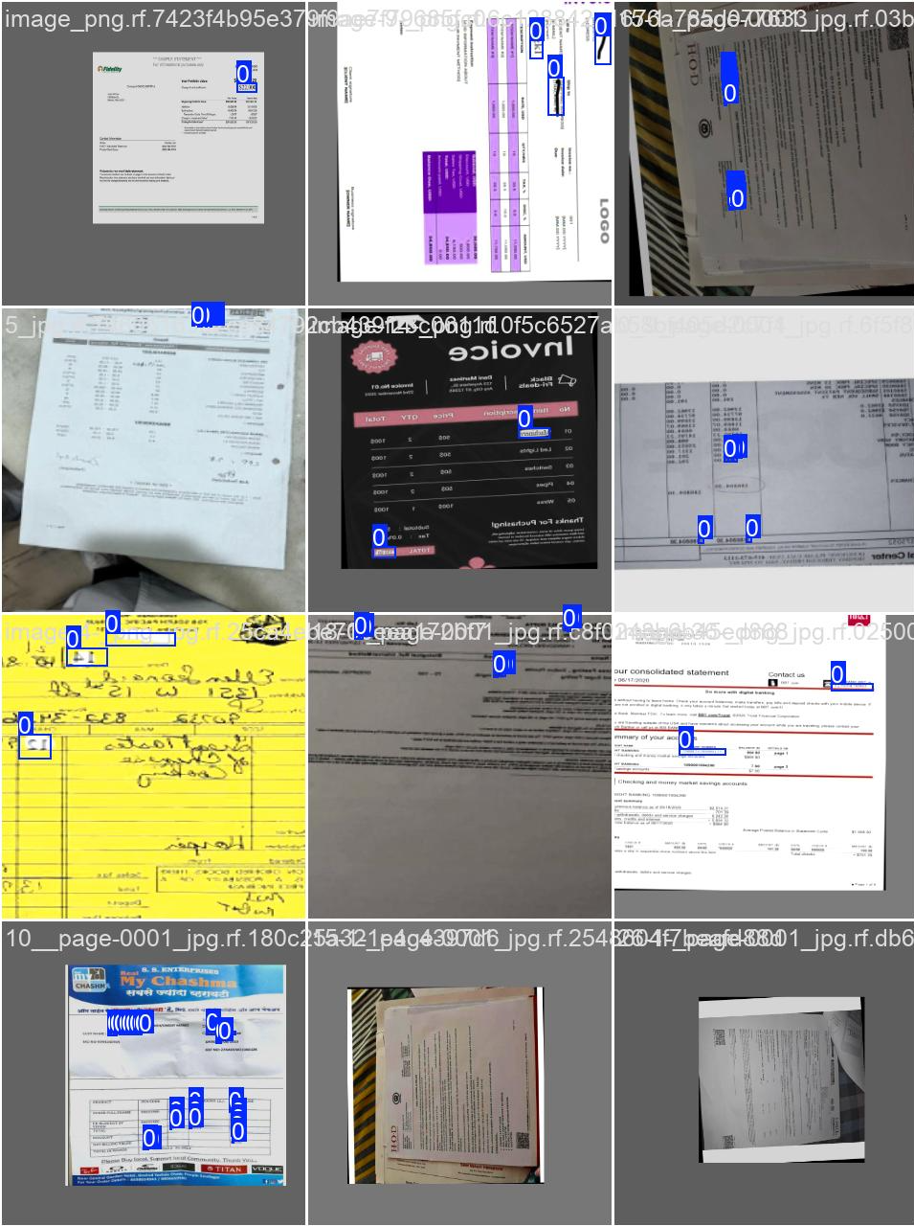
Test Results

Slide 18
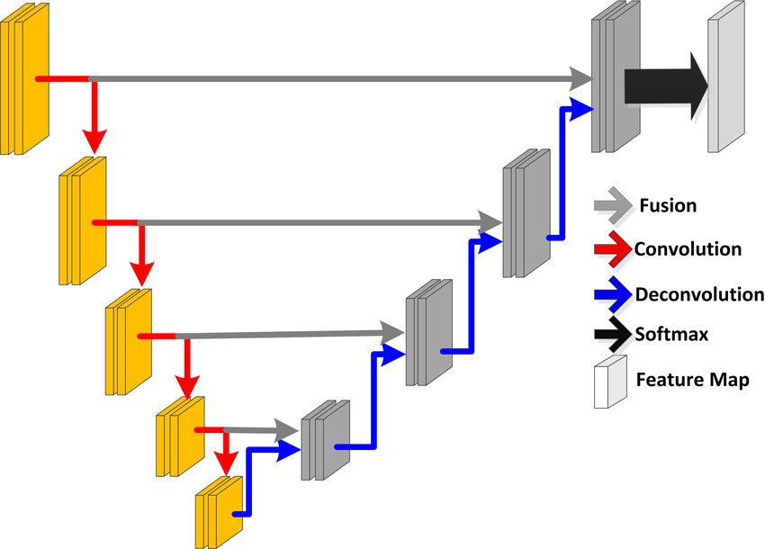
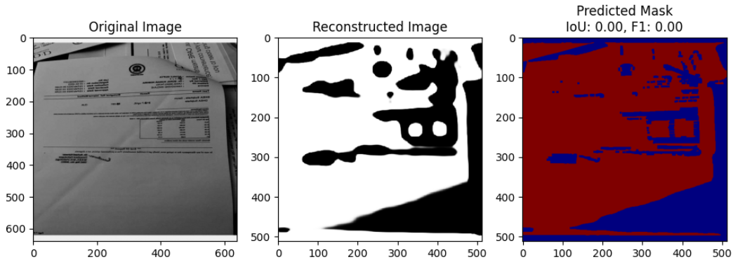
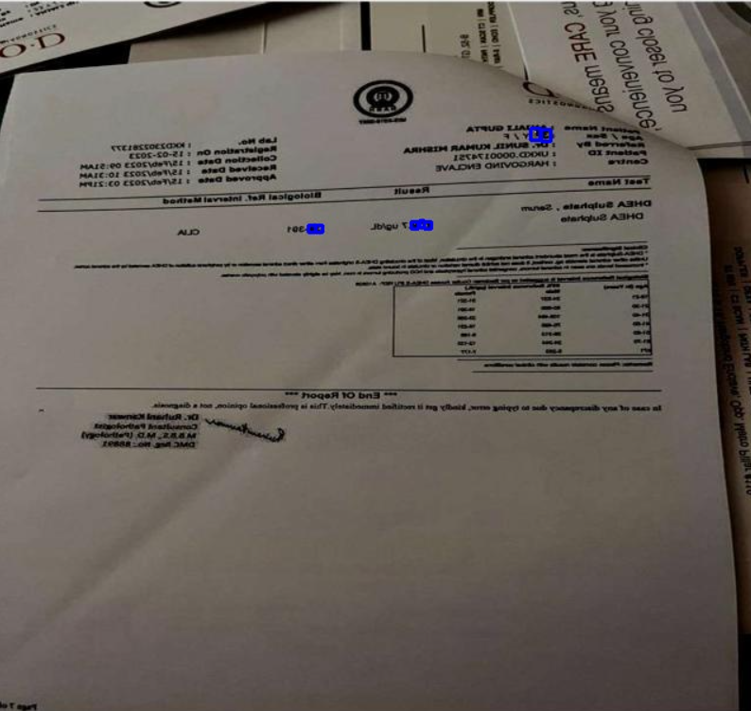
Other Models Explored
UNET
accuracy: 0.9832
f1_score: 0.0473
iou_metric: 0.0242
Autoencoder
Encoder: 3 convolutional layers + max pooling (extracts image features).
Decoder: 3 convolutional layers + upsampling (reconstructs the image).

Slide 19
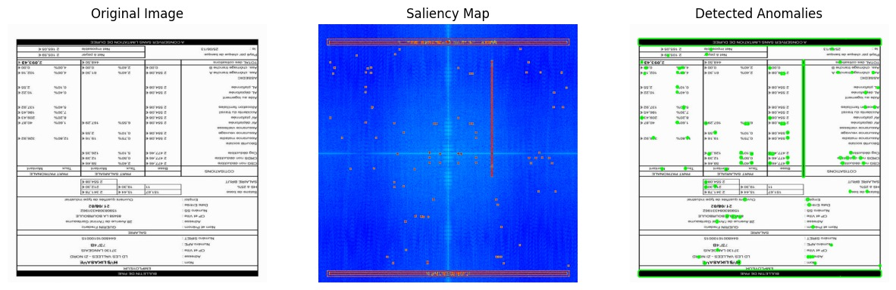
Other Models and processing methods
We have also explored various image processing techniques to assess their effectiveness in capturing forgery artifacts.
Saliency Maps-Identifies the most visually important regions in an image, often detecting unnatural modifications.

Slide 20
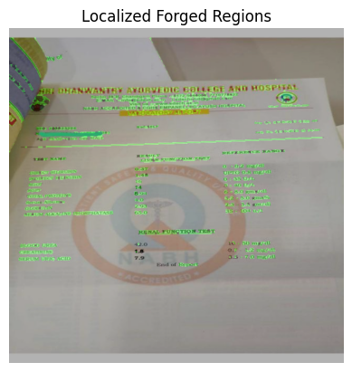
Processing methods
Since most of the dataset consists of grayscale images with text and edges, we explored Canny Edge Detection:
Canny Edge: Extracts sharp boundaries and edges, helping to highlight tampered regions where texture inconsistencies may be present.

Slide 21
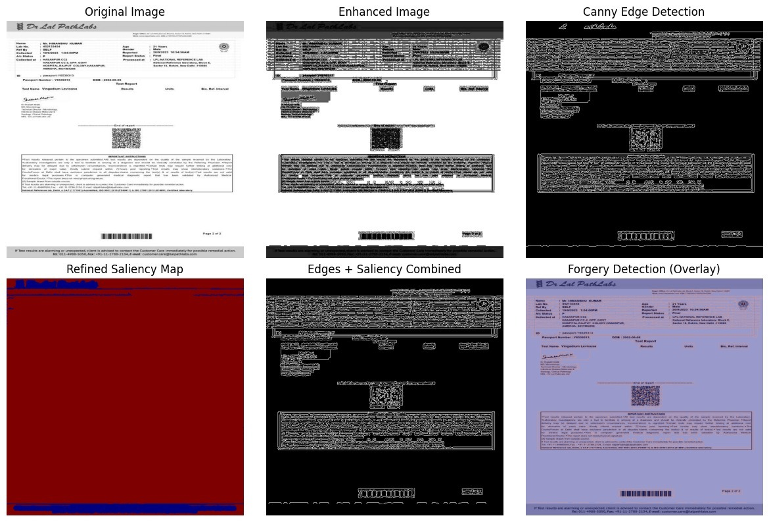
Processing methods
Canny Edge+Saliency-Morphological Operations for Edge Refinement and finally overlay the saliency and edge maps.

Slide 22
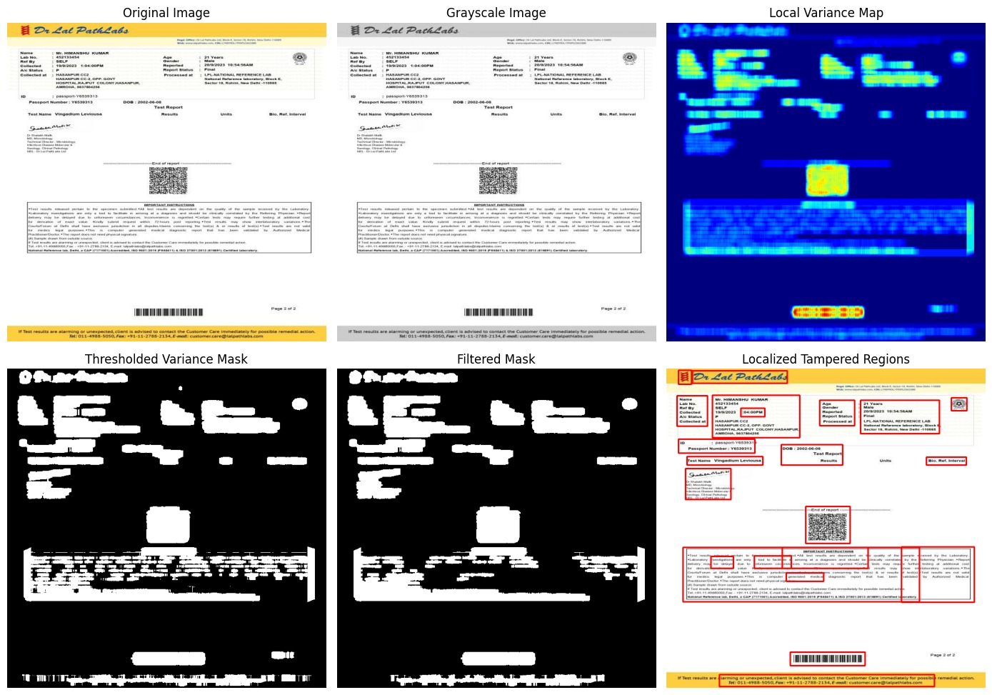
Processing methods
A Local Variance Map (LVM) calculates the variance (spread of pixel intensities) in small regions of an image. It helps highlight texture inconsistencies, noise, and forgery artifacts, making it useful for image forensics and tampering detection.

Slide 23
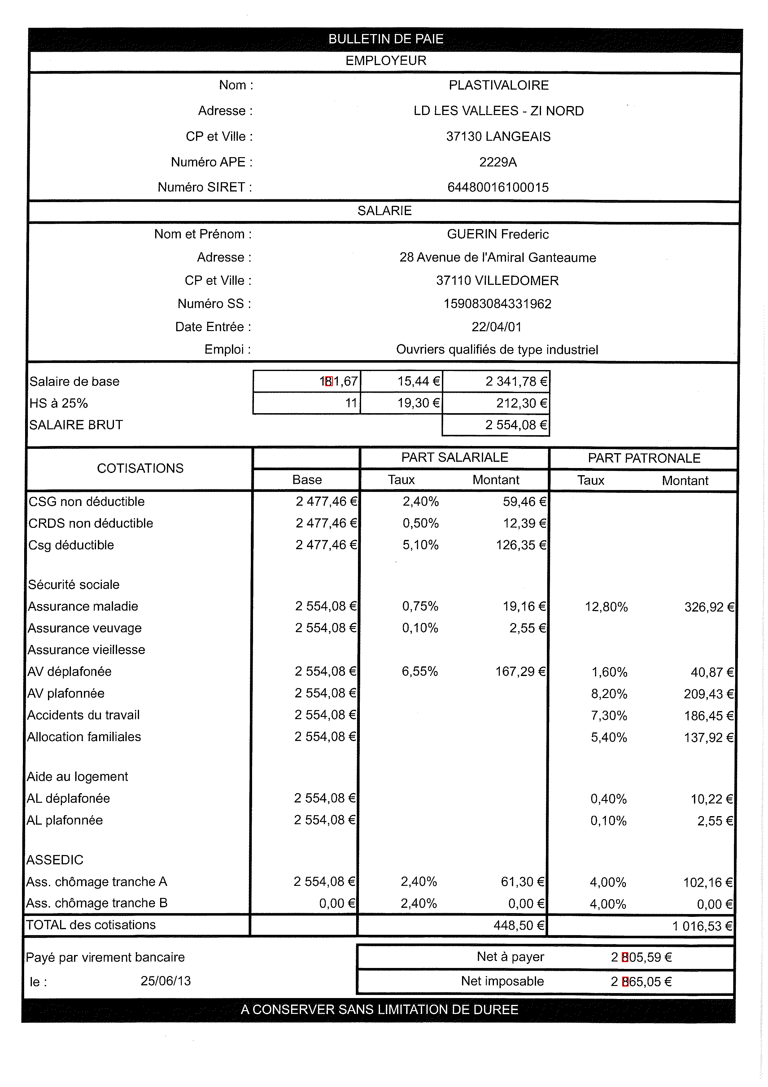
Challenges Observed
Limited Dataset Size → Very few images available for training, affecting model generalization.
Small Annotations → Each image has ~3 annotations, and they occupy very few pixels compared to the entire document, making it harder for the model to learn meaningful patterns.
Blurred Images → 10% of the dataset contains blurred images, reducing clarity and feature extraction quality.
Orientation Issues → 90% of images are tilted at different angles, making detection inconsistent.
Skew Correction Challenges → While skew correction was attempted, it did not fully align the images, leaving blank edges, which disrupts model training.

Slide 24
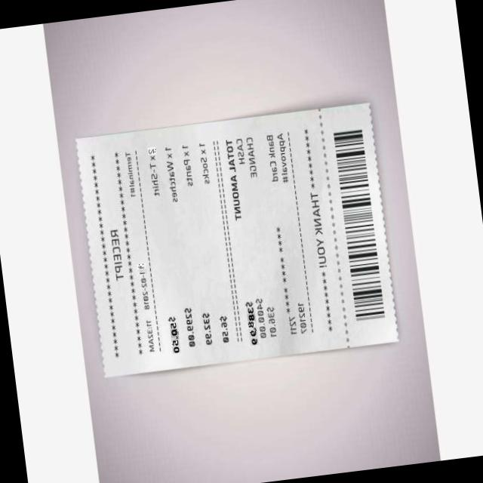
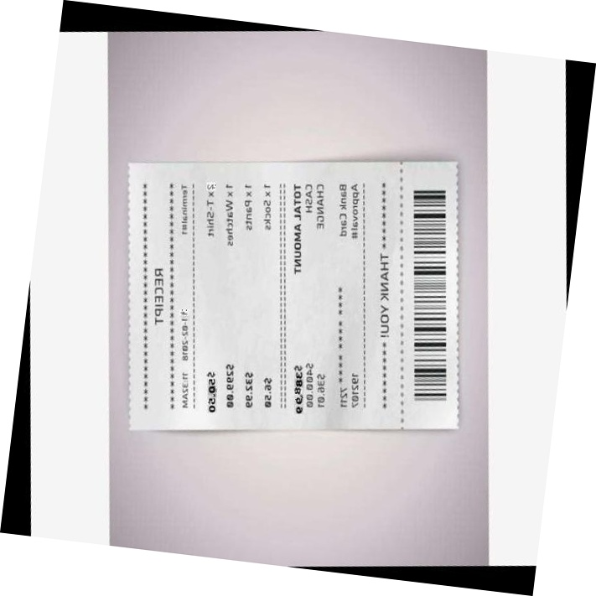
Challenges

Slide 25
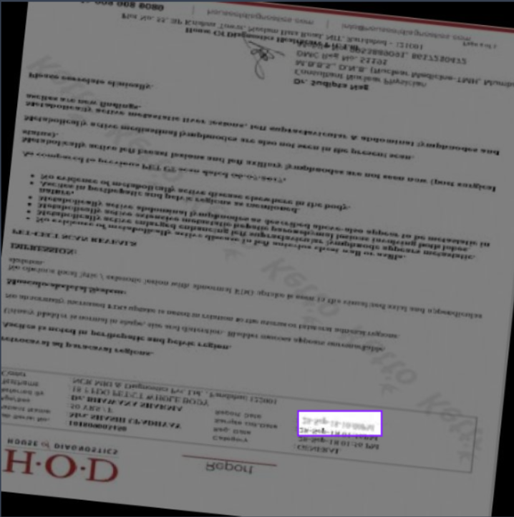
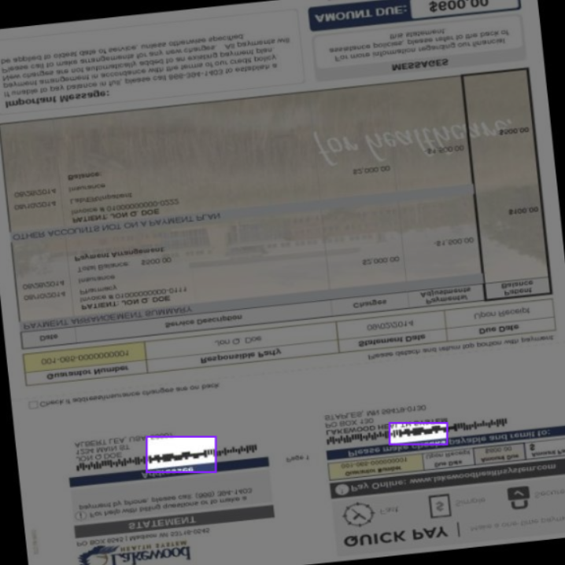
Challenges
Also the documents also consists of special characters rather than just text data

Slide 26
Inferences
YOLOv8 performed best among all models, effectively detecting tampered areas and key elements in documents like invoices, even with challenging dataset conditions.
Limitations:
performance is low for extremely blurred images, especially when details are unreadable even to the human eye.
Despite lower performance metrics, it visually highlights tampered regions well for images such as invoices with different colours rather than grayscale
Model :
The YOLOv8 model was hosted using Streamlit, allowing for real-time document forgery detection.
Real-Time Visualization:
Users can upload an image, and the system processes it instantly, highlighting tampered areas.
Provides an interactive and user-friendly interface for better analysis.
Results will be shown in streamlit website

Slide 27
INDIVIDUAL CONTRIBUTION
YOLOv8-Each person 2 variants
Mahammad Sami – Other Methods(canny edge and ela )
Vaibhav Sharma – Streamlit UI
Ujwal Srimanth - UNET
Vinayakan VS- auto encoder and dataset preparation

Slide 28
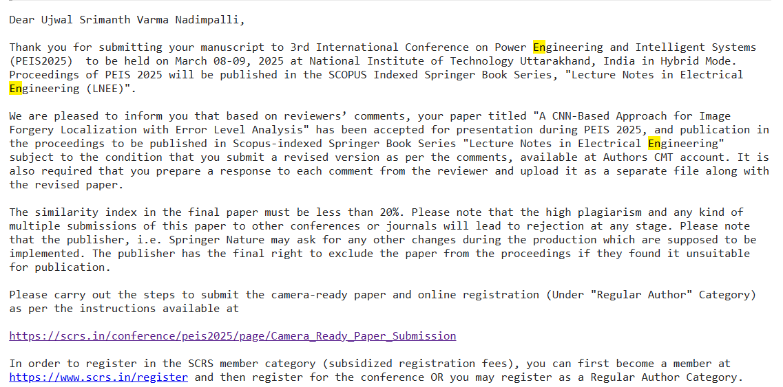
Publication Acceptance

Slide 29
References
[1] Document forgery detection, "Document Forgery Detection Dataset," Roboflow Universe, Apr. 2024. [Online]. Available: https://universe.roboflow.com/document-forgery-detection/document-forgery-detection. [Accessed: Mar. 6, 2025].
[2] M. Sohan, T. Sai Ram, R. Reddy, and C. Venkata, "A review on YOLOv8 and its advancements," in International Conference on Data Intelligence and Cognitive Informatics, Springer, 2024, pp. 529–545.
[3] G. Jocher, A. Chaurasia, and J. Qiu, Ultralytics YOLOv8, version 8.0.0, 2023. [Online]. Available: https://github.com/ultralytics/ultralytics.
[4] E. Xie, W. Wang, Z. Yu, A. Anandkumar, J. M. Alvarez, and P. Luo, "SegFormer: Simple and efficient design for semantic segmentation with transformers," Advances in Neural Information Processing Systems, vol. 34, pp. 12077–12090, 2021.
[5] T. R. Hayes and J. M. Henderson, "Deep saliency models learn low-, mid-, and high-level features to predict scene attention," Scientific Reports, vol. 11, no. 1, p. 18434, 2021.
[6] D. N. Raković, "Error level analysis (ELA)," Tehnika, vol. 78, no. 4, pp. 445–451, 2023.
[7]https://verifypdf.com/
[8]https://fotoforensics.com/
[9]https://viso.ai/wp-content/smush-webp/2023/12/Object-Detection-Architecture-Structre-1060x305.png.webp
[10]https://www.researchgate.net/publication/315514772/figure/fig2/AS:485824962797569@1492841105670/U-net-architecture-Each-box-corresponds-to-a-multi-channel-features-maps-The-number-of.png

Slide 30
THANK YOU

